Slide 1

Usage Funnels with Warby Parker
Petru Apachitei
Date: 07-12-2020

Slide 2
Table of Contents
Survey result.
Funnel analysis
Most popular model, price style and color.
Recommendation and additional insights

Slide 3
1. Survey result
To help users find their perfect frame, Warby Parker create a questionnaire with 5 question to help customer finding suitable pair of sunglass .
Create a query which counts the numbers of users answer for each question from survey table.
Calculate the completion rate of users for each question.
SELECT
question,
COUNT(*) as num_users
FROM survey
GROUP BY 1;
questions | num_users | Percentage(%)
1. What are you looking for? | 500 | 100
2. What's your fit? | 475 | 95
3. Which shapes do you like? | 380 | 80
4. Which colors do you like? | 361 | 95
5. When was your last eye exam? | 270 | 75

Slide 4
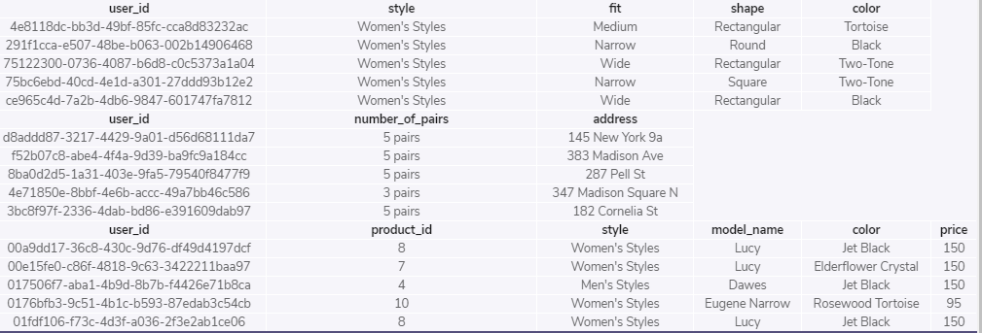
2.1 What are the column names for purchase funnel?
Warby Parker create a purchase funnel:
Take Style Quiz→ Home Try-On → Purchase of Glasses
During the Home
Table quiz has five columns: user_id, style, fit, shape and color. This table cover the users style type of glasses and within this table can determine the direction and tendency of customers glasses style.
Table home_try_on. This table represents list of users who received glasses to try on at home.
50% of the users will get 3 pairs to try on
50% of the users will get 5 pairs to try on
Table purchase have six columns: user_id, product_id, style, model_name, color, price. Within this table we’ll find out whether or not users who get more pairs to try at home we’ll be more likely to make a purchase.
ELECT *
FROM quiz
LIMIT 5;
-- home_try_on table
SELECT *
FROM home_try_on
LIMIT 5;
-- purchase table
SELECT *
FROM purchase
LIMIT 5;

Slide 5
2.2. Analyze data between three tables
Calculate conversion rate between quiz → home_try_on and home_try_on → purchase
From users who answered to quiz 750 received glasses at home and among these users 495 made a purchase.
with browse as
(SELECT DISTINCT q.user_id,
h.user_id IS NOT NULL as 'is_home_try_on',
h.number_of_pairs,
p.user_id IS NOT NULL as 'is_purchase'
FROM quiz q
LEFT JOIN home_try_on h
ON q.user_id = h.user_id
LEFT JOIN purchase p
ON q.user_id = p.user_id)
SELECT
COUNT(*) as quiz_users,
SUM(is_home_try_on) as try_on_users,
SUM(is_purchase) as purchase_users
FROM browse;
Tables | Num_users | percent(%)
quiz | 1000 | 100
home_try_on | 750 | 0.75
purchase | 495 | 0.66

Slide 6
2.3 Customers with three numbers of pairs and ones who had five
Create a query to calculate conversion rate between customers who received 5 pairs of glasses and those with 3 pairs.
80% from users who received five pairs purchased glasses
53% from users who received three pairs purchased glasses
with browse as
(SELECT DISTINCT q.user_id,
h.user_id IS NOT NULL as 'is_home_try_on',
h.number_of_pairs,
p.user_id IS NOT NULL as 'is_purchase'
FROM quiz q
LEFT JOIN home_try_on h
ON q.user_id = h.user_id
LEFT JOIN purchase p
ON q.user_id = p.user_id)
-- as conversion_rate
SELECT
number_of_pairs,
SUM(is_home_try_on) as try_on_users,
SUM(is_purchase) as purchase_users
FROM browse
WHERE number_of_pairs IS NOT NULL
GROUP BY 1;
Number_of_pairs | User_receive_glasses | Users_purchase_glasses | Percentage(%)
5 pairs | 371 | 294 | 80
3 pairs | 379 | 201 | 53

Slide 7
3.1 Most common style
Create a query to analyze most models :
People are more interested on women’s style than men’s style either answering or purchasing glasses
-- for types of glasses model name
with browse as
(SELECT DISTINCT q.user_id,
p.price,
p.color,
p.model_name,
h.user_id IS NOT NULL as 'is_home_try_on',
h.number_of_pairs,
p.user_id IS NOT NULL as 'is_purchase'
FROM quiz q
LEFT JOIN home_try_on h
ON q.user_id = h.user_id
LEFT JOIN purchase p
ON q.user_id = p.user_id)
SELECT
color,
price,
model_name,
SUM(is_purchase) as purchase_users
FROM browse
WHERE model_name IS NOT NULL
GROUP BY 1, 2, 3;
Style | Users_who_answer | Users_who_purchase
Women's Styles | 469 | 252
Men's Styles | 432 | 243
I'm not sure. Let's skip it. | 99 | 0

Slide 8
3.1 Most common model and color
Create a query to emphasize the most wanted glasses with respect to color, style and price.
ith browse as
(SELECT DISTINCT q.user_id,
p.style,
--p.price,
p.color,
p.model_name,
h.user_id IS NOT NULL as 'is_home_try_on',
h.number_of_pairs,
p.user_id IS NOT NULL as 'is_purchase'
FROM quiz q
LEFT JOIN home_try_on h
ON q.user_id = h.user_id
LEFT JOIN purchase p
ON q.user_id = p.user_id)
SELECT
model_name,
style,
color,
--price,
SUM(is_purchase) as purchase_users
FROM browse
WHERE model_name IS NOT NULL
GROUP BY 1;
model_name | style | color | purchase
Brady | Men's Styles | Layered Tortoise Matte | 95
Dawes | Men's Styles | Jet Black | 107
Eugene Narrow | Women's Styles | Rose Crystal | 116
Lucy | Women's Styles | Elderflower Crystal | 86
Monocle | Men's Styles | Endangered Tortoise | 41
Olive | Women's Styles | Pearled Tortoise | 50

Slide 9
4. Analyze data recommendation and additional insights
Conclusion:
Survey result
Survey shows lower competition rate for Q3, Q4 and Q5
Q3 some people do not have a preferred shape, they are used to try on glasses then select one who fits better. In this case would be benefic to have some models with different colors to try on or a software tool to take a picture of user and simulate with different shapes and colors.
Q5 in this case not all people had an eye exam.
2. Funnel analysis
Users who received more pairs at home were more likely to end up purchasing, 3 pairs 53% & 5pairs 80%.
3. Most common style and model.
Women’s style have better sale then Men’s style, difference is not significant.
For people who answered ‘I'm not sure. Let's skip it.’, none of these people try on home or purchased a pair of glasses.
Most popular women style model is Eugene Narrow.
Most popular men style model is Dawes.
Model Monocle and Olive have lower purchasing rate, Monocle model is a specific monocular type of frame therefore is not attractive to everyone, Olive is part of 2014 collection looks that is a little bit out of fashion.

